Slide 1
SCIENTIFIC FOUNDATION OF HEALTH
AVOIDING RISKS AND HARMFUL HABITS
DONE BY :
SHRIKANT
SAURABH
SANATH
SAYII GAGAN
AQEELUDDIN

Slide 2
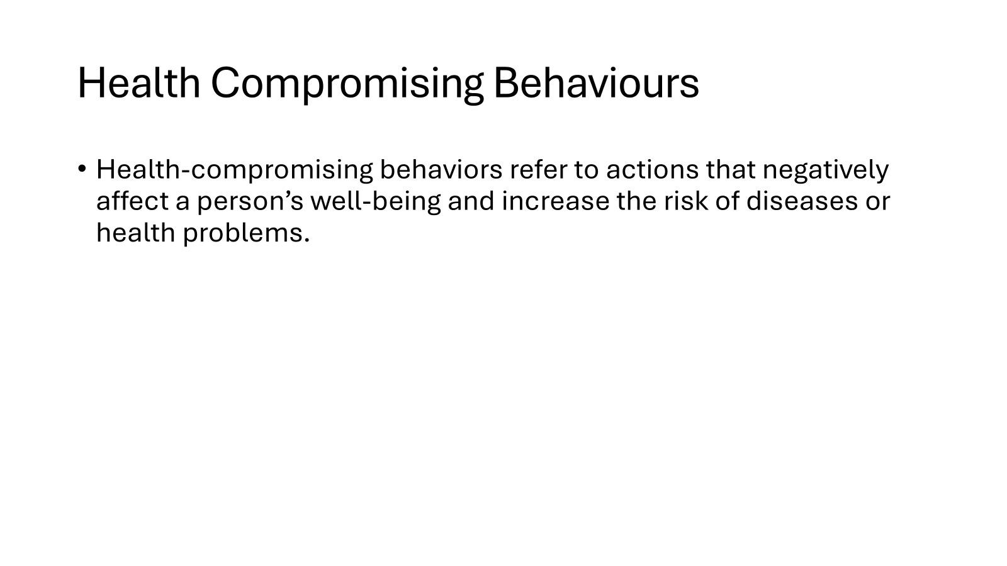

Slide 3
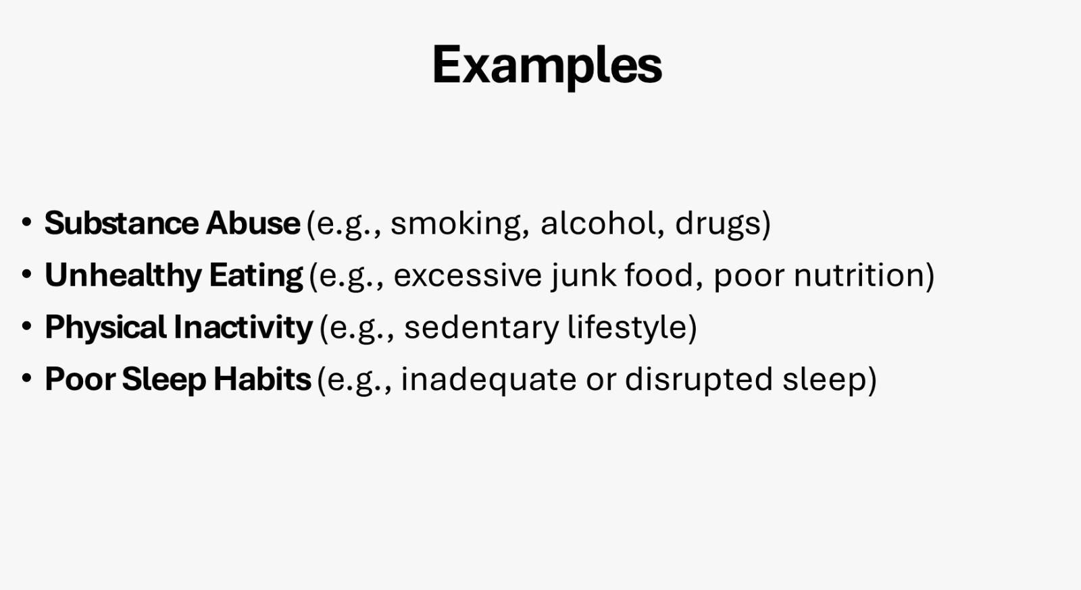

Slide 4
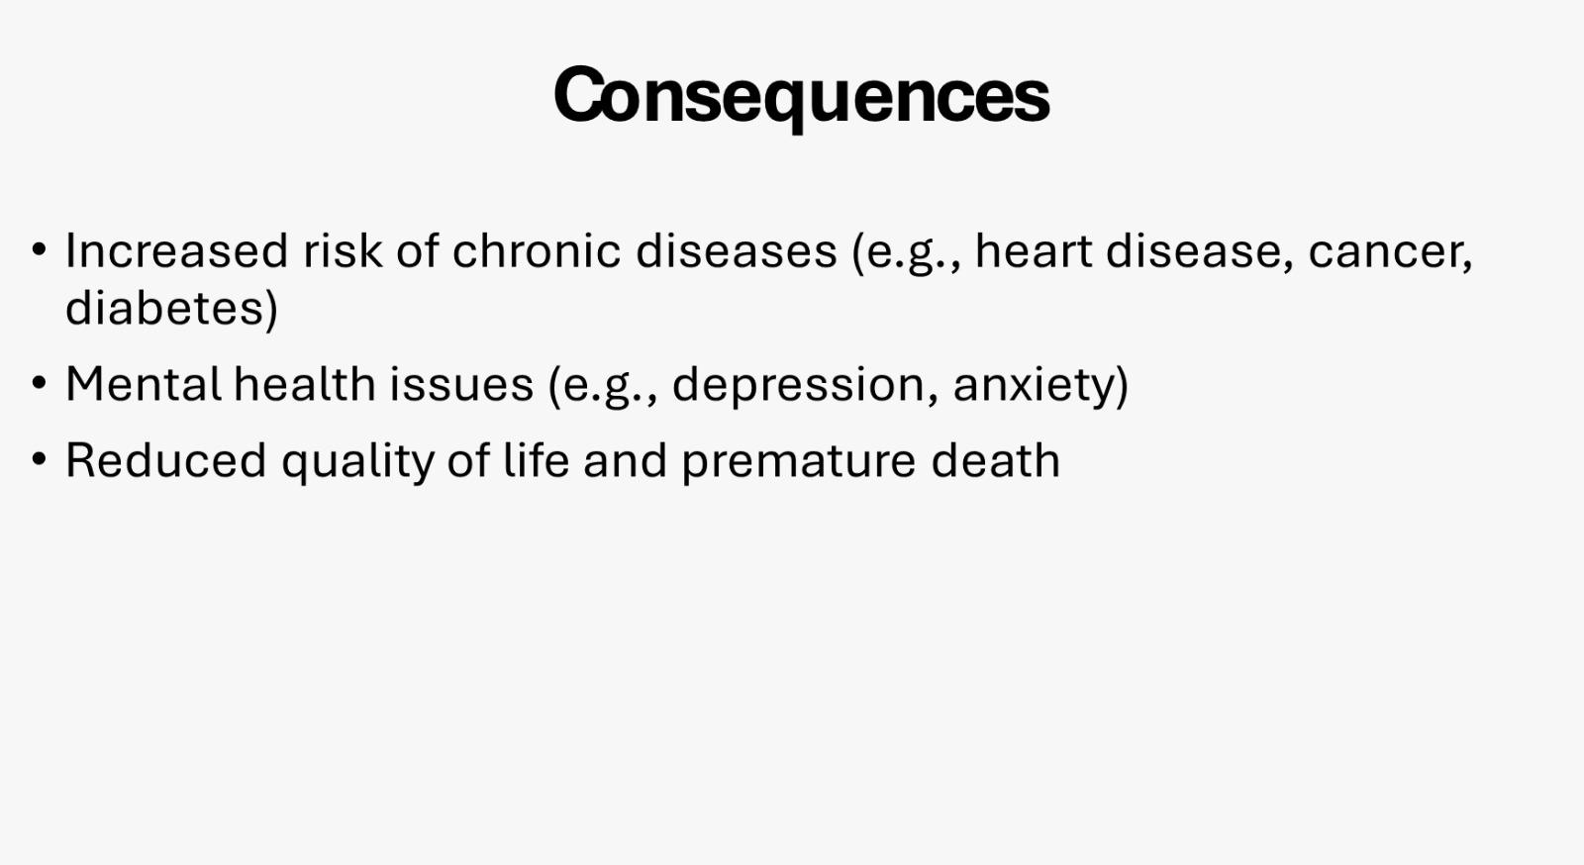

Slide 5


Slide 6


Slide 7


Slide 8


Slide 9


Slide 10


Slide 11


Slide 12


Slide 13


Slide 14
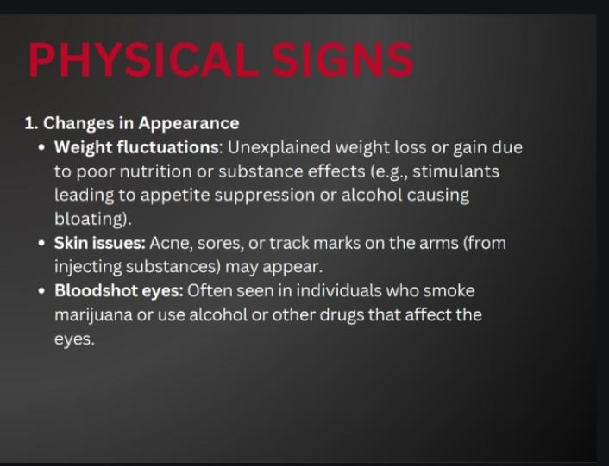

Slide 15
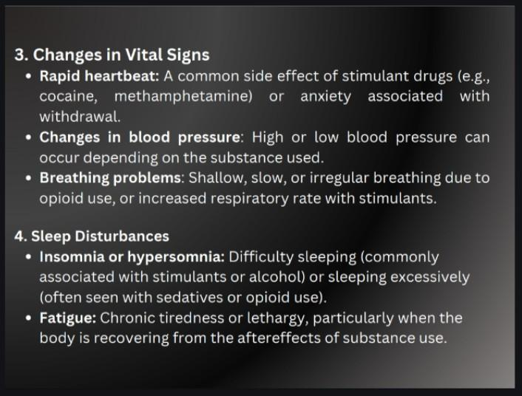

Slide 16


Slide 17


Slide 18


Slide 19
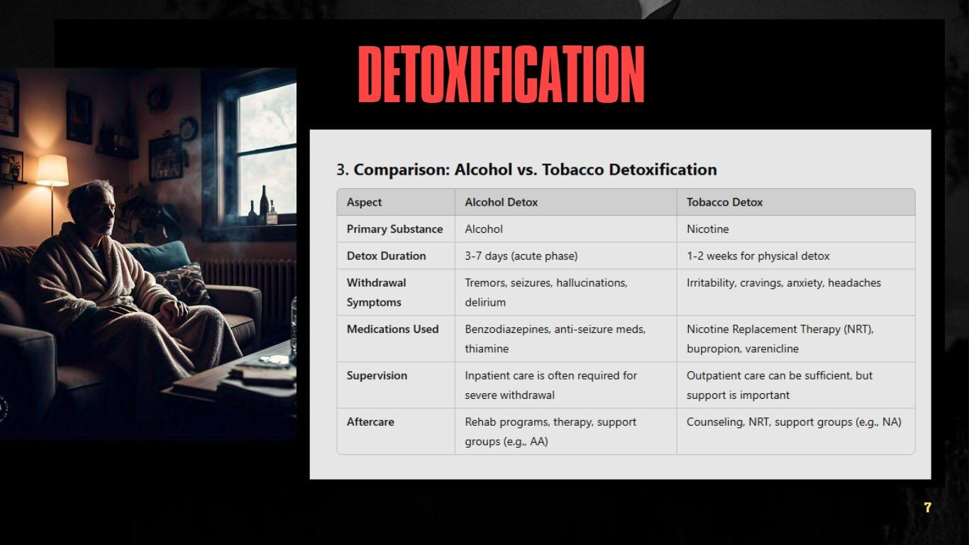

Slide 20


Slide 21


Slide 22
Thank you!

